Slide 1
Discrete Mathematics and Its Application 7th edition, 2001
Kenneth H. Rosen

Slide 2
Welcome to Discrete Mathematics Spring 2018
Instructor: Niu Shao Zhang

Slide 3
§2.3 Functions(函数)
函数也称为映射、变换。
定义1 设 f 是集合 A 到 B 的关系，如果对每个 x ∈ A ，有唯一的 y ∈ B ，则称 f 是 A 到 B 的映射，记为 f : A→B ，称 y 为 x 的象，记为f (x)；称 x 为 y 的原象。
函数的特点
⑴ A 的每个元素都要有象（存在性条件）
⑵ A 的每个元素都只有一个象（唯一性条件）
与高等数学中定义的函数相比，离散数学中的函数更广泛，不限于数集。

Slide 4
Section Summary
Definition of a Function.
Domain, Codomain
Image, Preimage
Injection, Surjection, Bijection
Inverse Function
Function Composition
Graphing Functions
Floor, Ceiling, Factorial
Partial Functions (optional)

Slide 5
Functions
Definition: Let A and B be nonempty sets. A function f from A to B, denoted f: A → B is an assignment of each element of A to exactly one element of B. We write f(a) = b if b is the unique element of B assigned by the function f to the element a of A.
Functions are sometimes
called mappings or
transformations.
Students
Grades
A
Carlota Rodriguez
B
Sandeep Patel
C
Jalen Williams
D
F
Kathy Scott

Slide 6
§2.3 Functions(函数)
函数可以看成是有序对做成的集合。
设 f 是集合 A ={a,b}到 B ={1,3,5}函数，且
f(a)=1, f(b)=3, 则
f={(a,1), (b,3)}

Slide 7
Functions
A function f: A → B can also be defined as a subset of A×B (a relation). This subset is restricted to be a relation where no two elements of the relation have the same first element.
Specifically, a function f from A to B contains one, and only one ordered pair (a, b) for every element a∈ A.
and

Slide 8
Graphical Representations
Functions can be represented graphically in several ways:
f
A
B
•
•
f
•
•
•
•
•
y
a
b
•
•
•
•
x
A
B
Bipartite Graph
Plot
Like Venn diagrams

Slide 9
Functions f : A→ B
A is called the domain（定义域）
B is called the codomain （陪域）.
If f(x) = y
y is called the image像(value值) of x under f
x is called a preimage源像(argument) of y
The range （值域） of f is the set of all images of points in A under f. It is denoted by f(A).
If S is a subset of A then
f(S) = {f(s) | s in S}.

Slide 10
Functions f : A→ B
设 f 是集合 A ={a,b}到 B ={1,3,5}函数，且
f(a)=1, f(b)=3, 则
The domain（定义域） is A ={a, b}
The codomain （陪域） is B ={1,3,5}.
The range （值域） of f is
f(A)={f(a), f(b)}={1,3}.
The image像(value值) of a is 1
The image像(value值) of b is 3
The preimage源像(argument) of 1 is a
The preimage源像(argument) of 3 is b
2 没有源像

Slide 11
Questions
z
f(a) = ?
A
B
The image of d is ?
z
a
x
The domain of f is ?
A
b
The codomain of f is ?
y
B
c
The preimage of y is ?
b
d
z
f(A) = ?
The preimage(s) of z is (are) ?
{a,c,d}

Slide 12
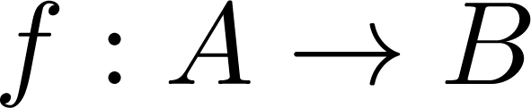
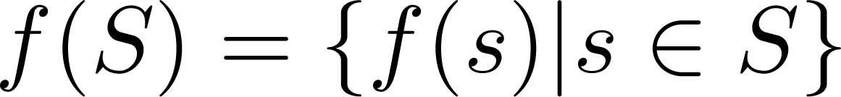
Question on Functions and Sets
If and S is a subset of A, then
A
B
f ({a,b,c,}) is ?
a
{y,z}
x
b
f ({c,d}) is ?
{z}
y
c
d
z

Slide 13
Injections
Definition: A function f is said to be one-to-one , or injective, if and only if f(a) = f(b) implies that a = b for all a and b in the domain of f. A function is said to be an injection if it is one-to-one.
(内射，单射，1-1映射）
A
B
a
x
v
b
y
c
z
d
w

Slide 14


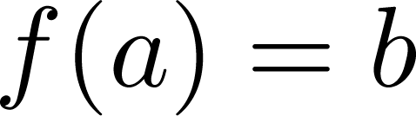
Surjections
Definition: A function f from A to B is called onto or surjective, if and only if for every element there is an element with . A function f is called a surjection if it is onto.
（满射，到上的）
A
B
a
x
b
y
c
z
d

Slide 15
Bijections
Definition: A function f is a one-to-one correspondence, or a bijection, if it is both one-to-one and onto (surjective and injective).
bijection 双射
surjective 满射的
injective 单射的
A
B
a
x
b
y
c
d
z
w

Slide 16
Range versus Codomain
The range of a function might not be its whole codomain.
The codomain is the set that the function is declared to map all domain values into.
The range is the particular set of values in the codomain that the function actually maps elements of the domain to.

Slide 17
Range vs. Codomain – Example
Suppose I declare to you that: “f is a function mapping students in this class to the set of grades {A,B,C,D,E}.”
At this point, you know f’s codomain is: __________, and its range is ________.
Suppose the grades turn out all As and Bs.
Then the range of f is _________, but its codomain is __________________.
{A,B,C,D,E}
unknown!
{A,B}
still {A,B,C,D,E}!

Slide 18
Operators (general definition)
An n-ary operator over (or on) the set S is any function from the set of ordered n-tuples of elements of S, to S itself.
E.g., if S={T,F}, ¬ can be seen as a unary operator, and ∧,∨ are binary operators on S.
Another example: ∪ and ∩ are binary operators on the set of all sets.

Slide 19
Constructing Function Operators
If • (“dot”) is any operator over A, then we can extend • to also denote an operator over functions f:A→A.
Given any binary operator •:A×A→A, then we can extend • to also denote an functions f: A×A→A
(a,b) →c
where c=f((a,b))= a•b

Slide 20
Special types of Functions
Injections（内射）
One-to-one （一对一）
Surjections （满射）
onto （上的）
Bijections （双射）
One-to-one and onto
One-to-one correspondence （一一对应）

Slide 21
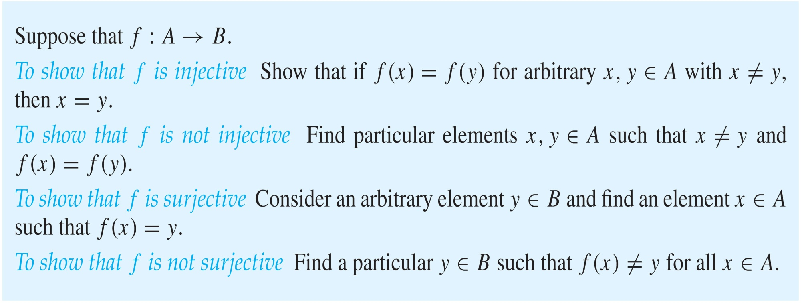
Showing that f is one-to-one or onto

Slide 22
Showing that f is one-to-one or onto
Example 1: Let f be the function from {a,b,c,d} to {1,2,3} defined by f(a) = 3, f(b) = 2, f(c) = 1, and f(d) = 3. Is f an onto function?
Solution: Yes, f is onto since all three elements of the codomain are images of elements in the domain. If the codomain were changed to {1,2,3,4}, f would not be onto.

Slide 23
Showing that f is one-to-one or onto
Example 2: Is the function f(x) = x² from the set of integers onto?
Solution: No, f is not onto because there is no integer x with x² = −1, for example.

Slide 24
One-to-One Illustration
Bipartite (2-part) graph representations of functions that are (or not) one-to-one:
•
•
•
•
•
•
•
•
•
•
•
•
•
•
•
•
•
•
•
•
•
•
•
•
•
•
•
Not even a function!
One-to-one
Not one-to-one

Slide 25
Illustration of Onto
Some functions that are, or are not, onto their codomains:
•
•
•
•
•
•
•
•
•
•
•
•
•
•
•
•
•
•
•
•
•
•
•
•
•
•
•
•
•
•
•
•
•
•
•
Onto (but not 1-1)
Not Onto (or 1-1)
Both 1-1 and onto
1-1 but not onto

Slide 26
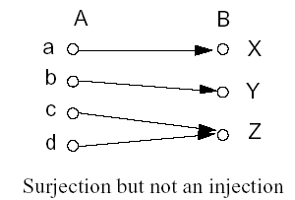
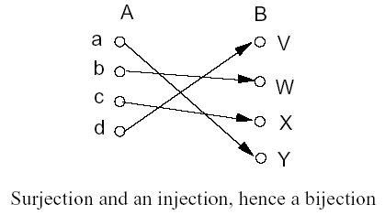
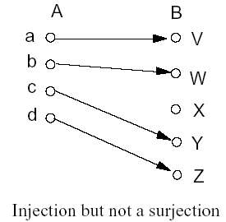
Examples

Slide 27
Examples:
Let
A = B =R
Determine which are injections, surjections, bijections:
f(x) = x,
f(x) = x²,
f(x) = x³,
f(x) = x + sin(x),
f(x) = | x |

Slide 28
Correspondence Principle
If two finite sets can be placed into 1-1 onto correspondence, then they have the same size.

Slide 29
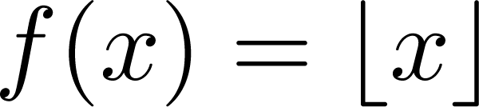
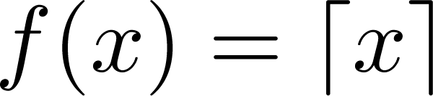
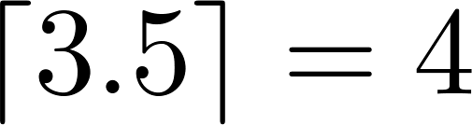
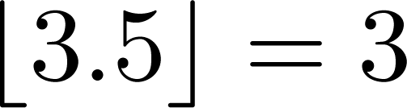
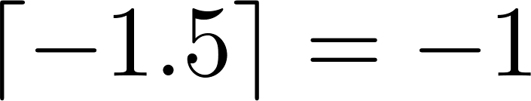
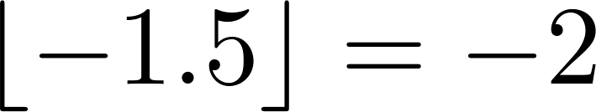
Some Important Functions
The floor function(rounded down), denoted
is the largest integer less than or equal to x.
The ceiling function (rounded up), denoted
is the smallest integer greater than or equal to x
Example:

Slide 30
Visualizing Floor & Ceiling
Real numbers “fall to their floor” or “rise to their ceiling.”
Note that if x∉Z, ⎣−x⎦ ≠ − ⎣x⎦ & ⎡−x⎤ ≠ − ⎡x⎤
Note that if x∈Z, ⎣x⎦ = ⎡x⎤ = x.
3
.
2
⎡1.6⎤=2
.
1.6
.
1
⎣1.6⎦=1
0
.
−1
⎡−1.4⎤= −1
.
−1.4
.
−2
.
.
.
⎣−1.4⎦= −2
−3
−3
⎡−3⎤=⎣−3⎦= −3

Slide 31
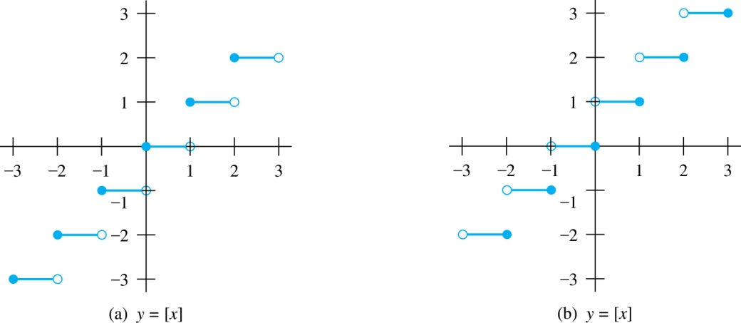
Floor and Ceiling Functions
Graph of (a) Floor and (b) Ceiling Functions

Slide 32
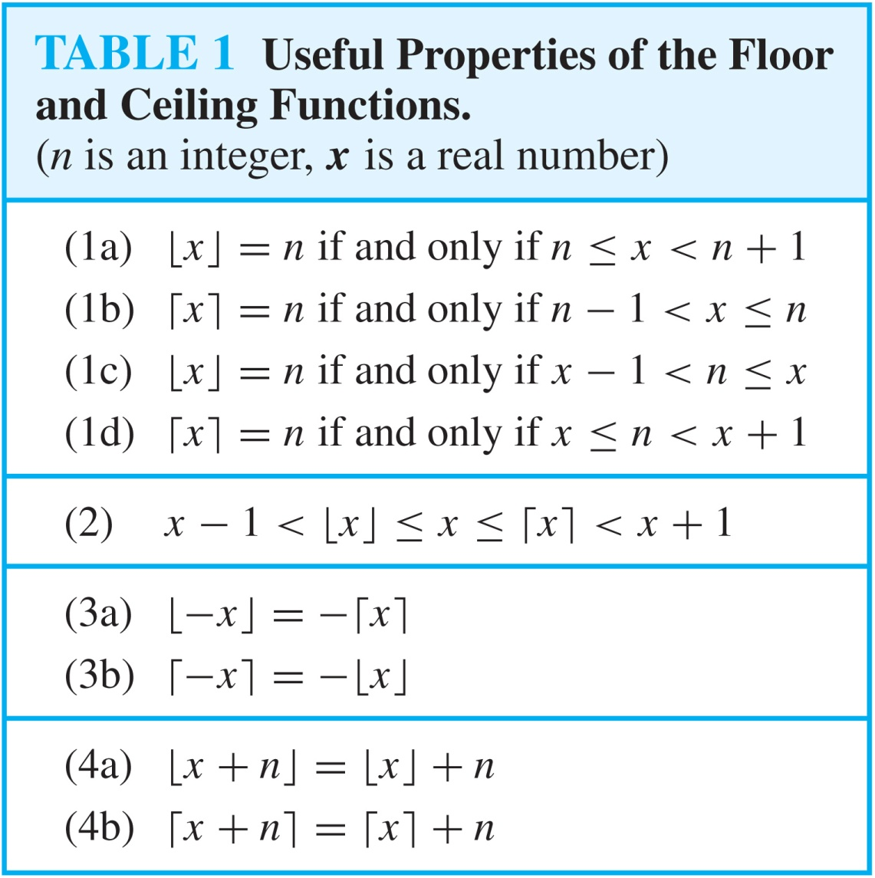
Floor and Ceiling Functions

Slide 33
Proving Properties of Functions
Example: Prove that x is a real number, then
⌊2x⌋= ⌊x⌋ + ⌊x + 1/2⌋
Solution: Let x = n + ε, where n is an integer and 0 ≤ ε< 1.
Case 1: ε < ½
2x = 2n + 2ε and ⌊2x⌋ = 2n, since 0 ≤ 2ε< 1.
⌊x + 1/2⌋ = n, since x + ½ = n + (1/2 + ε ) and 0 ≤ ½ +ε < 1.
Hence, ⌊2x⌋ = 2n and ⌊x⌋ + ⌊x + 1/2⌋ = n + n = 2n.
Case 2: ε ≥ ½
2x = 2n + 2ε = (2n + 1) +(2ε − 1) and ⌊2x⌋ =2n + 1, since 0 ≤ 2 ε - 1< 1.
⌊x + 1/2⌋ = ⌊ n + (1/2 + ε)⌋ = ⌊ n + 1 + (ε – 1/2)⌋ = n + 1 since 0 ≤ ε – 1/2< 1.
Hence, ⌊2x⌋ = 2n + 1 and ⌊x⌋ + ⌊x + 1/2⌋ = n + (n + 1)
= 2n + 1.

Slide 34
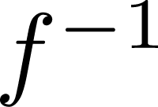
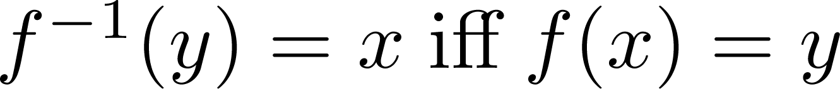
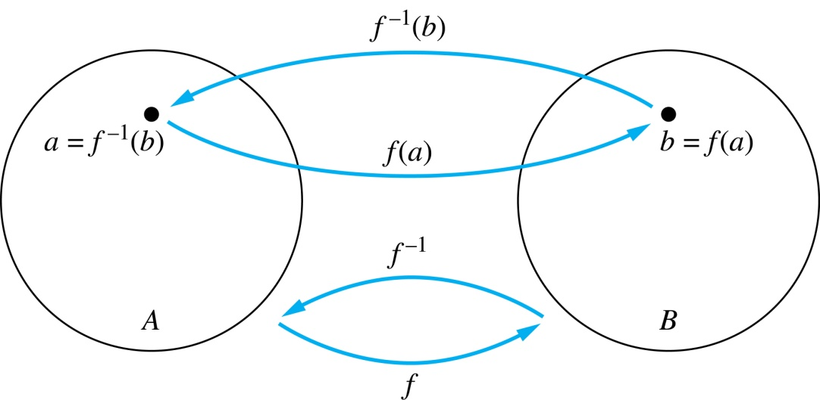
Inverse Functions
Definition: Let f be a bijection from A to B. Then the inverse of f, denoted , is the function from B to A defined as
No inverse exists unless f is a bijection. Why?

Slide 35
Inverse Functions
A
B
A
B
f
a
V
V
a
b
b
W
W
c
c
d
X
X
d
Y
Y

Slide 36
Questions
Example 1: Let f be the function from {a,b,c} to {1,2,3} such that f(a) = 2, f(b) = 3, and f(c) = 1. Is f invertible and if so what is its inverse?
Solution: The function f is invertible because it is a one-to-one correspondence. The inverse function f⁻¹ reverses the correspondence given by f, so f⁻¹ (1) = c, f⁻¹ (2) = a, and f⁻¹ (3) = b.

Slide 37
The Identity Function
For any domain A, the identity function I:A→A (variously written, I_{A}, 1, 1_{A}) is the unique function such that ∀a∈A: I(a)=a.
Some identity functions you’ve seen:
+ing 0, ·ing by 1, ∧ing with T, ∨ing with F, ∪ing with ∅, ∩ing with U.
Note that the identity function is always both one-to-one and onto (bijective).

Slide 38
Identity Function Illustrations
The identity function:
•
•
•
y
y = I(x) = x
•
•
•
•
•
•
Domain and range
x

Slide 39
Inverse Functions
Definition: Let f be a bijection from A to B. Then the inverse of f, denoted f⁻¹, is the function from B to A defined as
f⁻¹(y) = x iff f(x) = y
f is said to be invertible(可逆的)

Slide 40
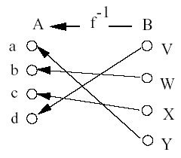
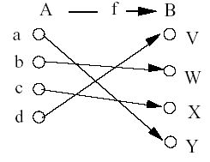
Inverse Functions
Note: No inverse exists unless f is a bijection.

Slide 41
Questions
Example 2: Let f: Z → Z be such that f(x) = x + 1. Is f invertible, and if so, what is its inverse?
Solution: The function f is invertible because it is a one-to-one correspondence. The inverse function f⁻¹ reverses the correspondence so f⁻¹ (y) = y – 1.

Slide 42
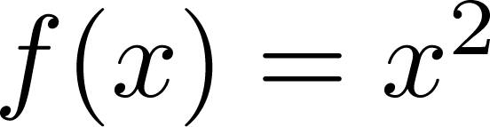
Questions
Example 3: Let f: R → R be such that
. Is f invertible, and if so, what is its inverse?
Solution: The function f is not invertible because it is not one-to-one .

Slide 43
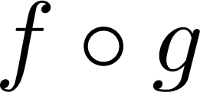
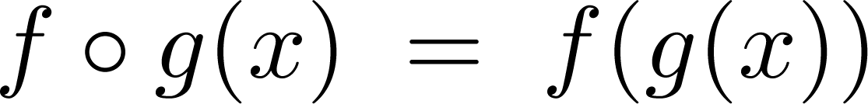
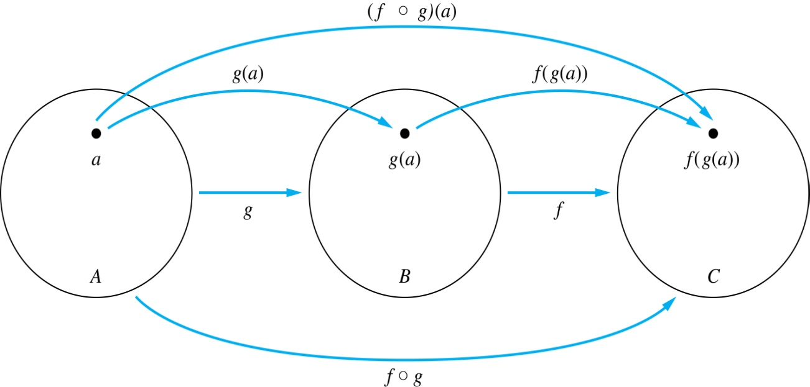
Composition
Definition: Let f: B → C, g: A → B. The composition of f with g, denoted is the function from A to C defined by

Slide 44
Composition
A
g
B
f
C
A
C
a
V
a
h
h
b
i
W
b
c
i
X
j
c
d
d
j
Y

Slide 45
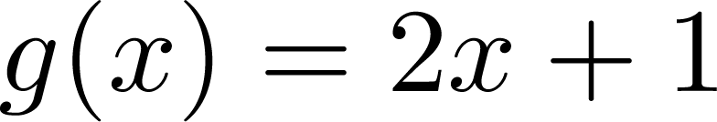
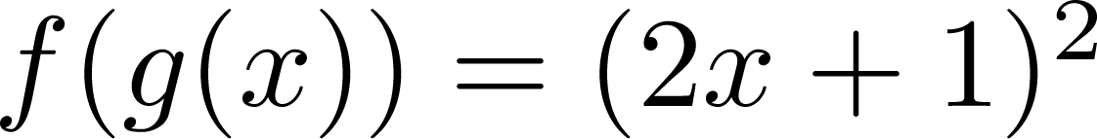
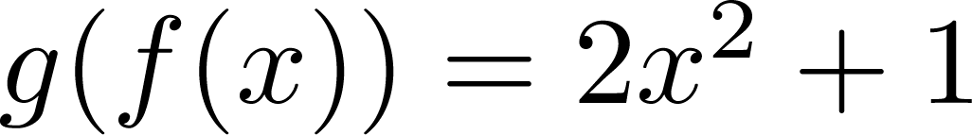
Composition
Example 1: If and , then
and

Slide 46
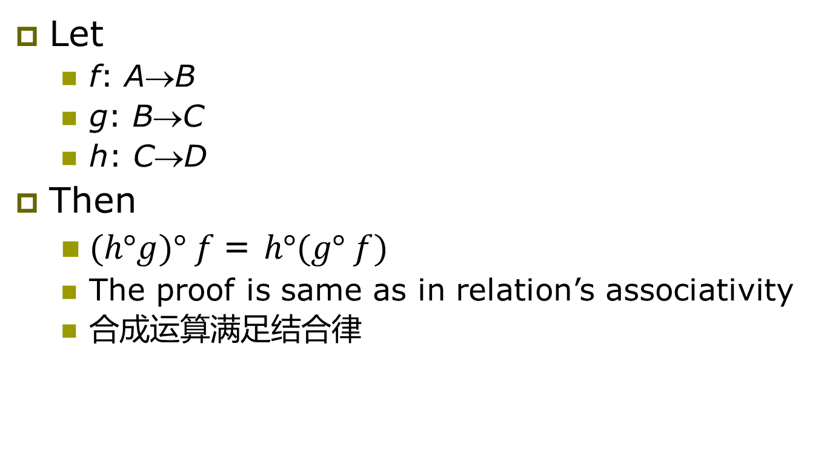
Composition
Let
f: A→B
g: B→C
h: C→D
Then
$(h°g)° f$= $h°(g° f)$
The proof is same as in relation’s associativity
合成运算满足结合律

Slide 47
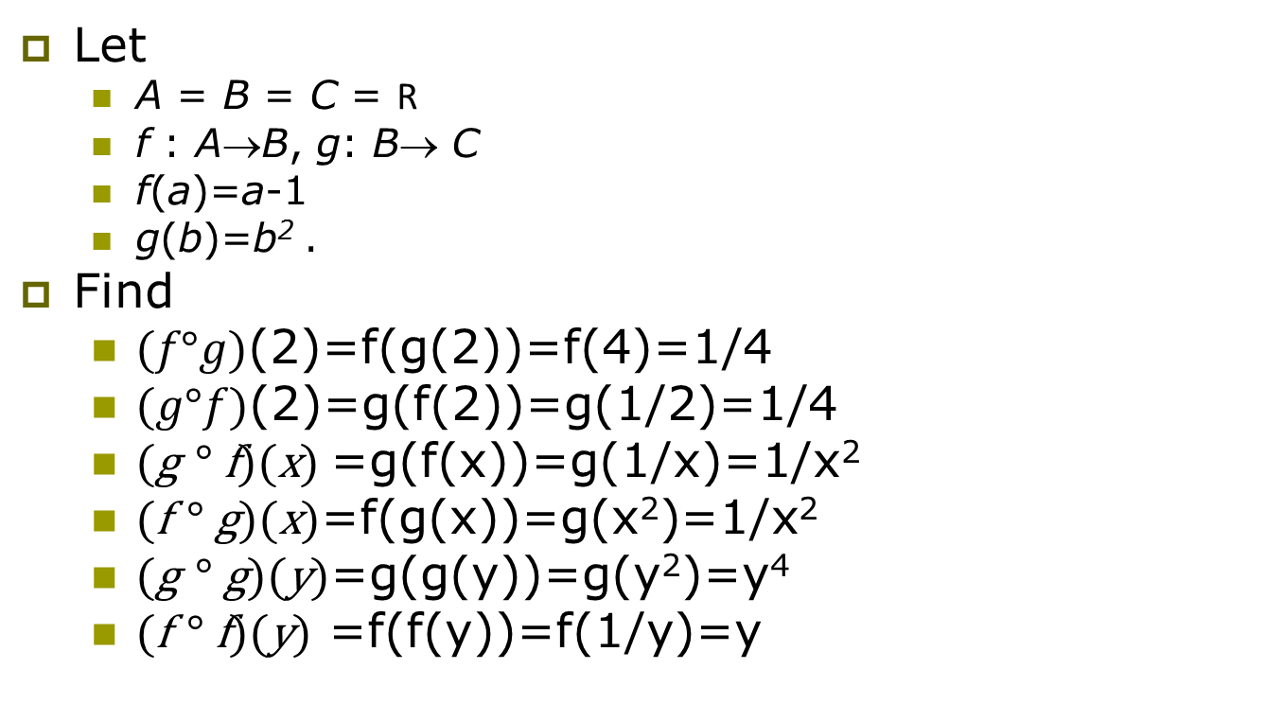
Exercise
Let
A = B = C = R
f : A→B, g: B→ C
f(a)=a-1
g(b)=b² .
Find
$(f°g)$(2)=f(g(2))=f(4)=1/4
$(g°f)$(2)=g(f(2))=g(1/2)=1/4
(g $°$f)(x) =g(f(x))=g(1/x)=1/x²
(f $°$g)(x)=f(g(x))=g(x²)=1/x²
(g $°$g)(y)=g(g(y))=g(y²)=y⁴
(f $°$f)(y) =f(f(y))=f(1/y)=y

Slide 48
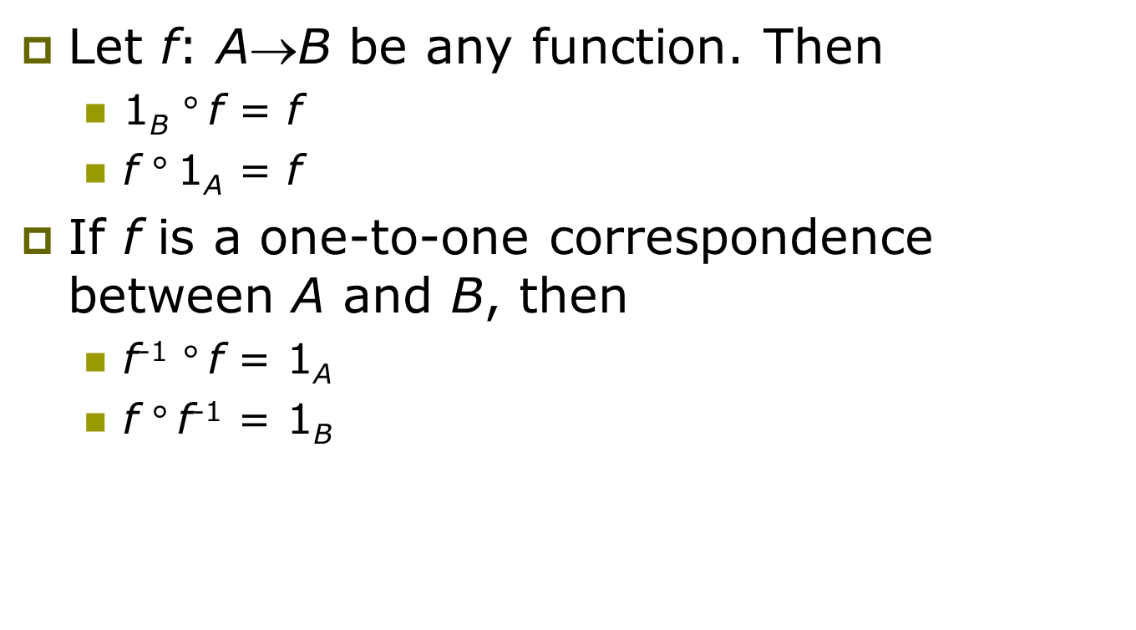
Theorem
Let f: A→B be any function. Then
1_{B} $°$f = f
f $°$1_{A} = f
If f is a one-to-one correspondence between A and B, then
f⁻¹ $°$f = 1_{A}
f $°$f⁻¹ = 1_{B}

Slide 49
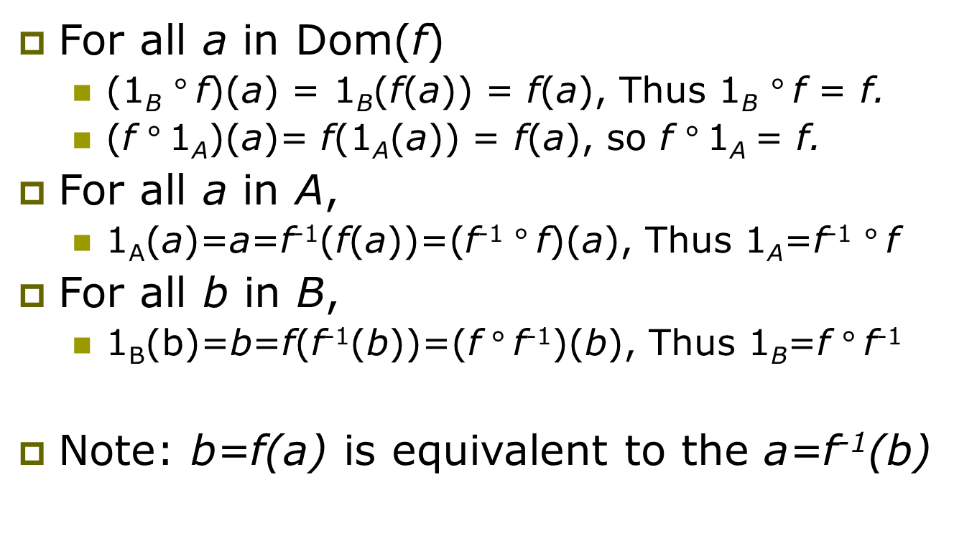
Proof
For all a in Dom(f)
(1_{B} $°$f)(a) = 1_{B}(f(a)) = f(a), Thus 1_{B} $°$f = f.
(f $°$1_{A})(a)= f(1_{A}(a)) = f(a), so f $°$1_{A} = f.
For all a in A,
1_{A}(a)=a=f⁻¹(f(a))=(f⁻¹ $°$f)(a), Thus 1_{A}=f⁻¹ $°$f
For all b in B,
1_{B}(b)=b=f(f⁻¹(b))=(f $°$f⁻¹)(b), Thus 1_{B}=f $°$f⁻¹
Note: b=f(a) is equivalent to the a=f⁻¹(b)

Slide 50
Graphs of Functions
We can represent a function f:A→B as a set of ordered pairs {(a,f(a)) | a∈A}.
Note that ∀a, there is only 1 pair (a,b).
Later (ch.6): relations loosen this restriction.
For functions over numbers, we can represent an ordered pair (x,y) as a point on a plane.
A function is then drawn as a curve (set of points), with only one y for each x.
← The function’s graph.

Slide 51
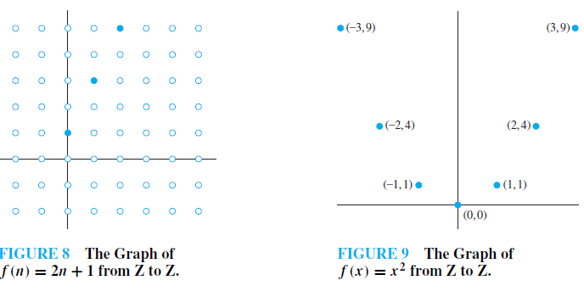
Example 24
Example 25

Slide 52
Plots with floor/ceiling: Example
Plot of graph of function f(x) = ⎣x/3⎦:
f(x)
Set of points (x, f(x))
+2
−3
+3
x
−2

Slide 53
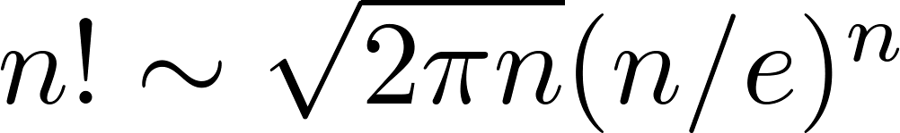
Factorial Function
Definition: f: N → Z⁺ , denoted by f(n) = n! is the product of the first n positive integers when n is a nonnegative integer.
f(n) = 1 ∙ 2 ∙∙∙ (n – 1) ∙ n, f(0) = 0! = 1
Examples:
^{f(1) = 1! = 1}
^{f(2) = 2! = 1 ∙ 2 = 2}
^{f(6) = 6! = 1 ∙ 2 ∙ 3∙ 4∙ 5} ^{∙ 6 = 720}
f(20) = 2,432,902,008,176,640,000.
Stirling’s Formula:

Slide 54
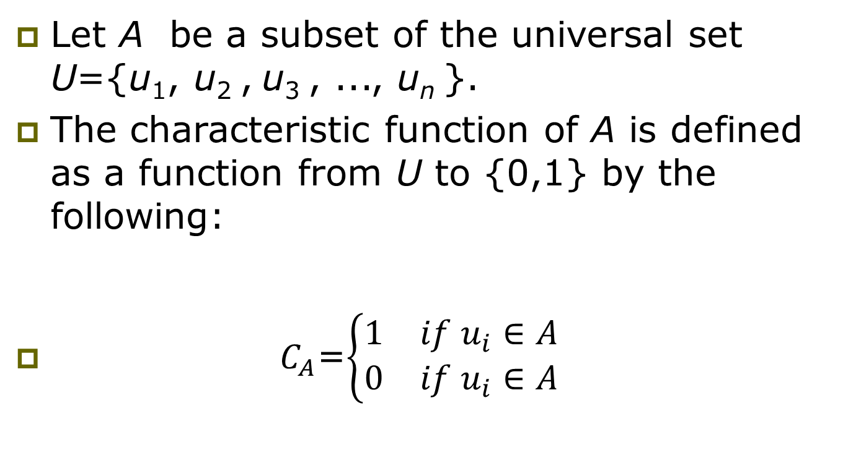
Characteristic Functions(特征函数)
Let A be a subset of the universal set U={u₁, u₂ , u₃ , ..., u_{n} }.
The characteristic function of A is defined as a function from U to {0,1} by the following:
$C_{A}$=$\left\{\begin{matrix}1 & if u_{i}∈A \\ 0 & if u_{i}∈A\end{matrix}\right.$

Slide 55
Characteristic Functions
Example
if
A={4, 7, 9}
U={1, 2, 3, …, 10},
then
C_{A}(2)=0,
C_{A}(4)=1,
C_{A}(7)=1,
C_{A}(12) is undefined.
Note: C_{A} is onto but not one to one

Slide 56
Mod-n Functions(模n函数)
Let f_{n} is a function from the nonnegative integers to the set {0, 1, 2, 3,…, n-1}.
For a fixed n, any nonnegative integer z can be written as
z=kn+r with 0≤r<n ,
Then
f_{n}(z)=r or z ≡ r (mod n).
Note: f_{n} is onto but not one to one

Slide 57
Partial Functions (optional)
Definition: A partial function f from a set A to a set B is an assignment to each element a in a subset of A, called the domain of definition of f, of a unique element b in B.
The sets A and B are called the domain and codomain of f, respectively.
We day that f is undefined for elements in A that are not in the domain of definition of f.
When the domain of definition of f equals A, we say that f is a total function.

Slide 58
Partial Functions (optional)
Example: f: N → R where f(n) = √n is a partial function from Z to R where the domain of definition is the set of nonnegative integers. Note that f is undefined for negative integers.

Slide 59
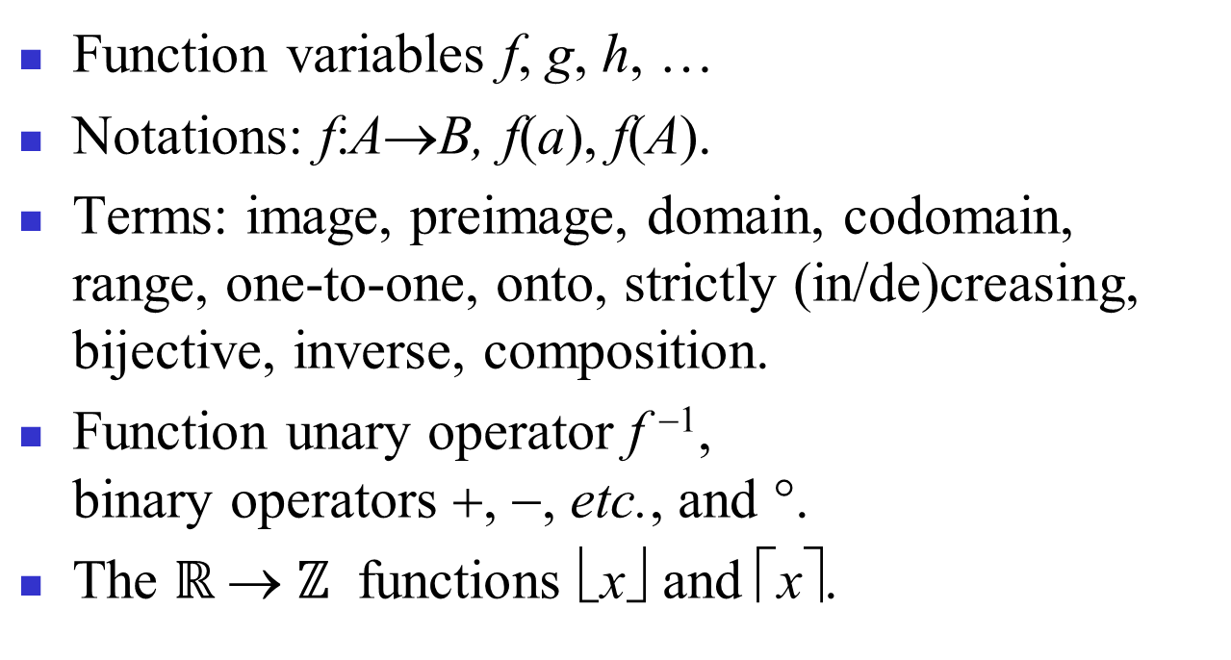
Review of §2.3 (Functions)

Slide 60
Homework
§2.3
8, 20, 24, 33, 64

